Slide 1
SRI RAMAKRISHNA ENGINEERING COLLEGE [Educational Service: SNR Sons Charitable Trust] [Autonomous Institution, Reaccredited by NAAC with ‘A+’ Grade] [Approved by AICTE and Permanently Affiliated to Anna University, Chennai] [ISO 9001:2015 Certified and all eligible programmes Accredited by NBA] VATTAMALAIPALAYAM, N.G.G.O. COLONY POST, COIMBATORE – 641 022
20EC280 – Mini Project II
“Development of Neuropatch : A Smart Skin Patch for Brain Monitoring and Response”
SDG GOALS MAPPED Nos. : SDG 3
Type of Project: Research
Presented by
Pooja Nivethidha M – 71812302139
Preethi B – 71812302145
Priyadharshini H – 71812302149
Supervised by
Dr.R.Karthikamani
Assistant Professor(Sl.G)/ECE
Batch No: 3EC28
Project viva-voce Examination
Date : 16.04.2026

Slide 2
Contents
S.No | Description | Slide Number
1 | Introduction | 3
2 | Literature Survey | 4-8
3 | Problem identification, scope and objective | 9-10
4 | Existing technology of the project | 11-12
5 | Methodology (Flow Diagrams) | 13
6 | Design, Experimentation, Coding etc.- Technical feasibility | 14-17
7 | Costing & Financial feasibility compared to existing model / technology | 18
8 | Results and Discussion | 19-20
9 | Scope for future Work | 21
10 | Outcome of the Projects | 22
11 | Participation in events (Patent, Paper, Hackatons etc.,) – applied / published / granted | 23
12 | SDG Goals & References | 24

Slide 3
Introduction
Traditional brain monitoring systems rely on bulky EEG headsets and hospital-based wired setups, which limit patient mobility and real-time application.
•Current diagnostic approaches for neurological conditions like paralysis, seizures, coma stages, and Alzheimer’s disease often require manual EEG interpretation, resulting in delayed response and limited accessibility.
•“NeuroPatch” proposes a smart, non-invasive skin patch integrated with EEG sensors and AI models to enable real-time brain signal monitoring and automated detection.
•The project applies deep learning models like CNN and LSTM trained on EEG datasets to identify abnormal neural patterns linked to specific conditions.
•The methodology includes EEG data collection using wearable sensors, preprocessing and feature extraction , model training with deep learning, hardware integration with microcontrollers, and mobile-based alert systems.
•The system is tested through simulation and real-time signal input, offering high accuracy, portability, and a proactive approach to brain health management.

Slide 4
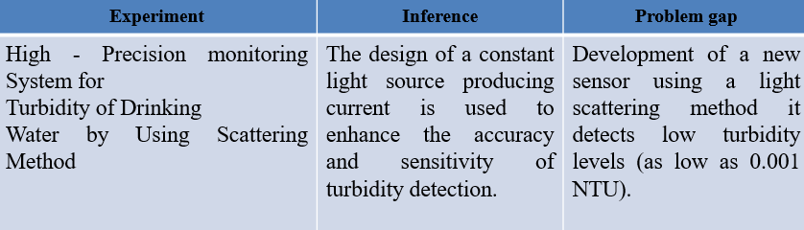
Literature Survey – 01
Source:
“ A Sleep Stage-Decoding Forehead EEG Patch for Real-time Modulation of Sleep “,William G. Coon, Preston Peranich, and Griffin Milsap,Not published in a peer reviewed journal yet ,2025 (Version 2 posted on 6 June 2025),As it is on arXiv, it is not indexed in Scopus. However, authors may submit it to a journal later for peer-reviewed publication and indexing.

Slide 5
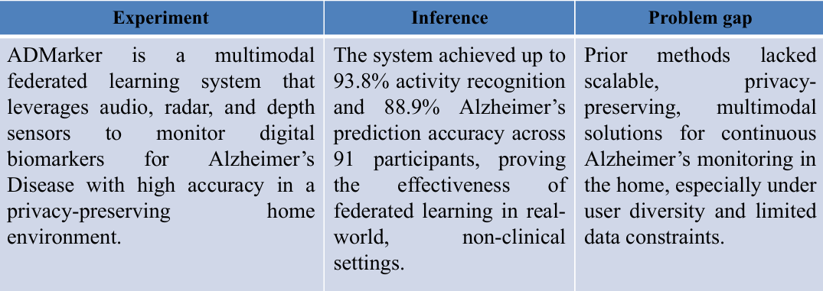
Literature Survey - 02
Source:
ADMarker: A Multi-Modal Federated Learning System for Monitoring Digital Biomarkers of Alzheimer's Disease” , Xiaomin Ouyang et al., ACM MobiCom ’24, 1 16, 2024 , 10.1145/3636534.3649370, Yes

Slide 6
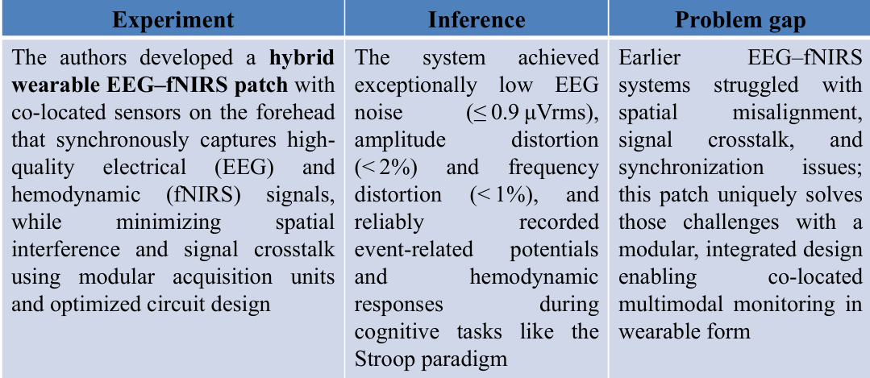
Literature Survey - 03
Source:
“Hybrid Integrated Wearable Patch for Brain EEG-fNI Analysis”, Changhyun Lee, Hyeonseo Song, Jaeyoung Kim, Youngjun Yun, and Hoi-Jun Yoo, IEEE Transactions on Biomedical Circuits and Systems, 16, 6, 1352–1364,2022, Yes (IEEE journals are Scopus indexed)

Slide 7
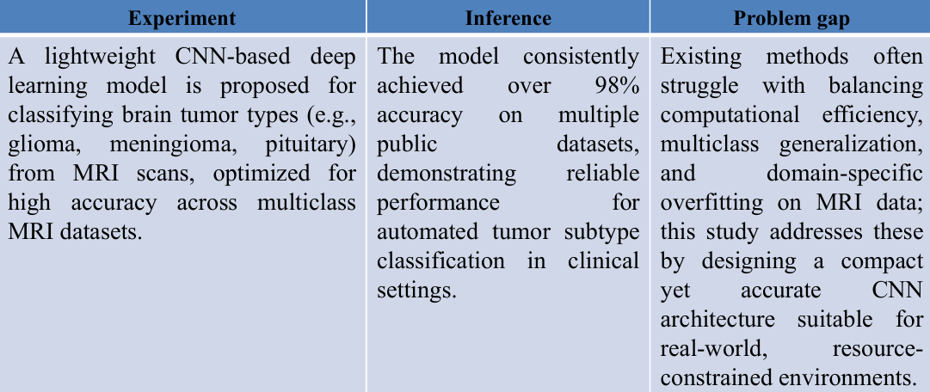
Literature Survey - 04
Source:
“An Efficient Deep Learning Approach for Brain Tumor Classification Using MRI Images”, Safa Hamoud Aljuaid, Rania Kora Ahmed,IEEE Access, 10, Not specified (IEEE Access publishes continuously) 121119–121132, 2022, Yes (IEEE Access is Scopus indexed)

Slide 8
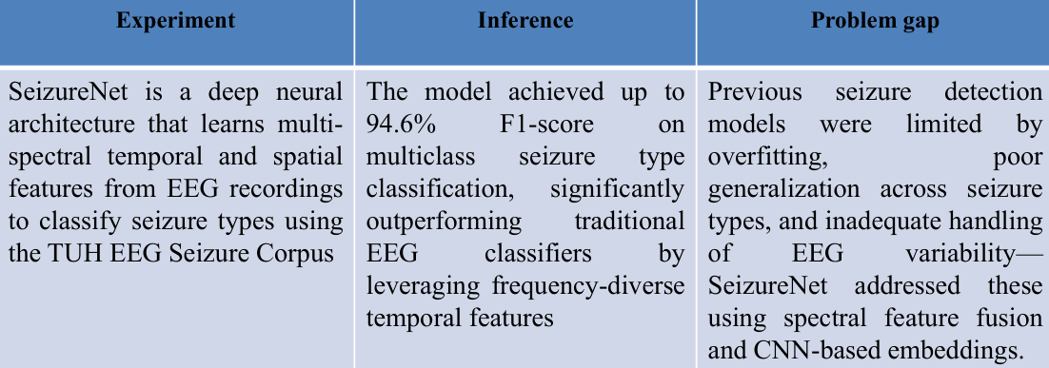
Literature Survey - 05
Source:
”EEG-Based Epileptic Seizure Detection via Machine Learning Algorithms “, Ahmad B. A. Hassanat, Mohammad Rawashdeh, Mohammed A. Alqaralleh, Ghada M. Altarawneh, Aseel Awajan,Computational Intelligence and Neuroscience 2022, 2336575, 11 pages, 2022, No (This paper has been retracted, and while the journal is 9 Scopus indexed, the retracted paper is no longer valid for citation)

Slide 9
Problem identification, scope and objectives (Contd.,)
Problem Definition
Traditional brain monitoring systems are bulky, hospital-dependent, and lack real-time, wearable solutions for early detection of neurological disorders like seizures, coma, paralysis, and Alzheimer’s. Scope:
Scope
This project aims to develop a smart, wearable EEG-based skin patch (NeuroPatch) that uses AI to detect brain abnormalities and send real-time alerts via wireless communication.

Slide 10
Problem identification, scope and objectives
Objectives
To design and develop a compact and wearable system for continuous monitoring of brain activity.
To acquire, process, and analyze brain signals in real time for detecting abnormal neurological patterns.
To enable wireless monitoring and provide instant alerts during critical conditions for improved patient safety.

Slide 11
Existing technology of the project
Wearable EEG Headbands & Caps
• Wearable EEG headbands, such as those developed by Muse or NeuroSky, integrate electrodes into flexible bands or caps. While not as precise as full clinical systems, they provide a good balance of comfort and utility for personal-use scenarios.[Biology Insights Wikipedia ] The g.Nautilus Research and PRO Flexible series are research-grade, offering configurable dry or wet electrodes in 8 to 64-channel setups, high fidelity data, and wireless communication.[g.tec medical engineering+1 ]
Dry-Electrode & Motion-Resistant Systems
• Recent EEG headsets like Diadem incorporate dry electrodes and active shielding for robust signal quality—even during movement—making them suitable for real-world, daily use.[Bitbrain ] The Nuance EEG headset incorporates mobile EEG technology with strong resistance to motion artifacts—ideal for applications requiring stability and durability.[EigenSensor ]
Integrated Multimodal Headsets
• OpenBCI’s Galea integrates multiple physiological sensors (EEG, EMG, EDA, PPG, eye tracking) into a single headset platform—ideal for immersive neurotech applications.[Wikipedia • Consumer and Clinical Applications • Muse headband: popular for real-time neurofeedback and meditation, easily worn at home.[Wikipedia ]

Slide 12
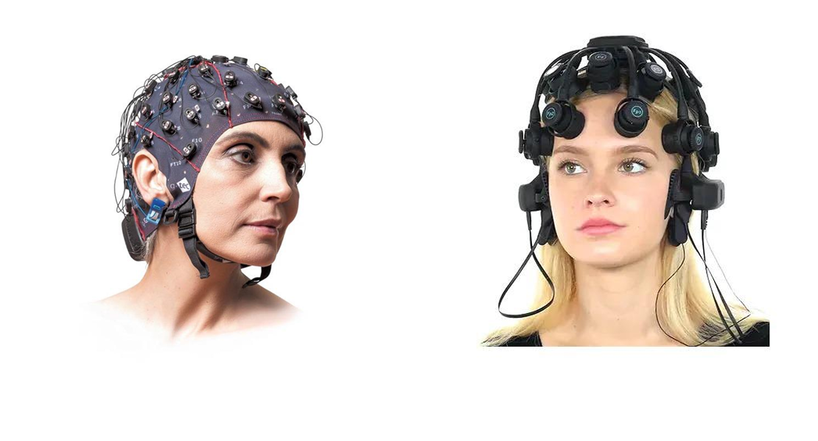
Existing technology of the project
Photographs

Slide 13
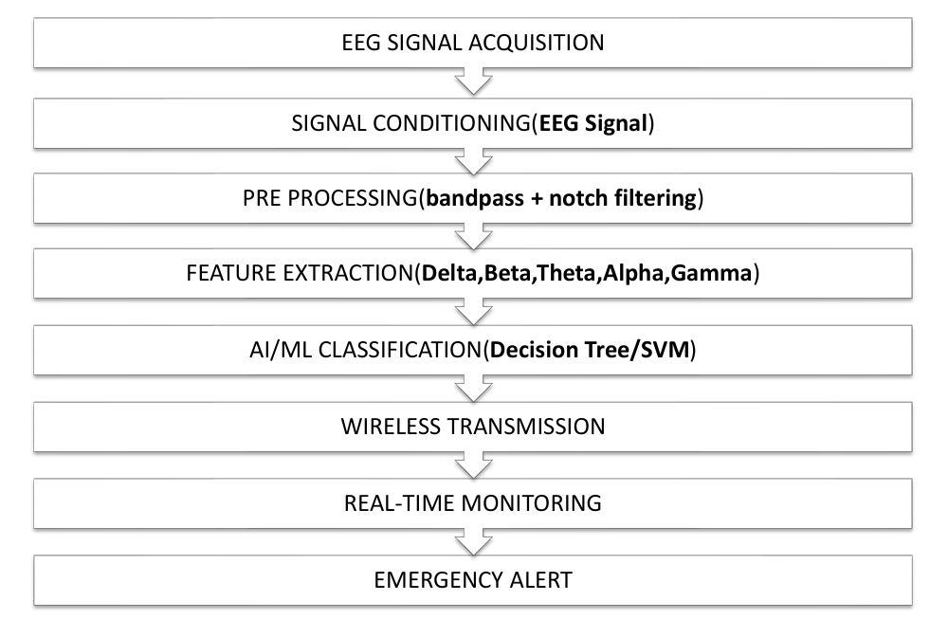
Methodology
Process Flow Diagram

Slide 14
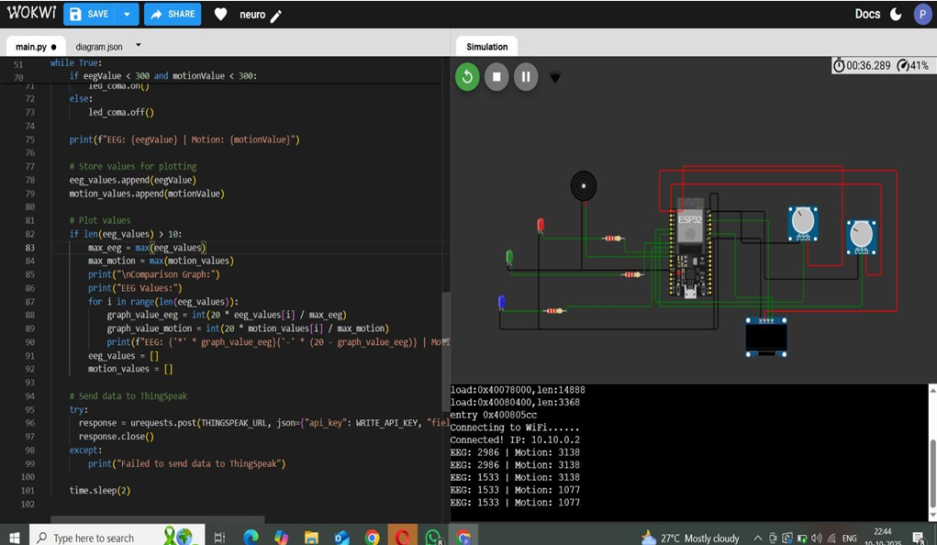
Design & Experimentation

Slide 15
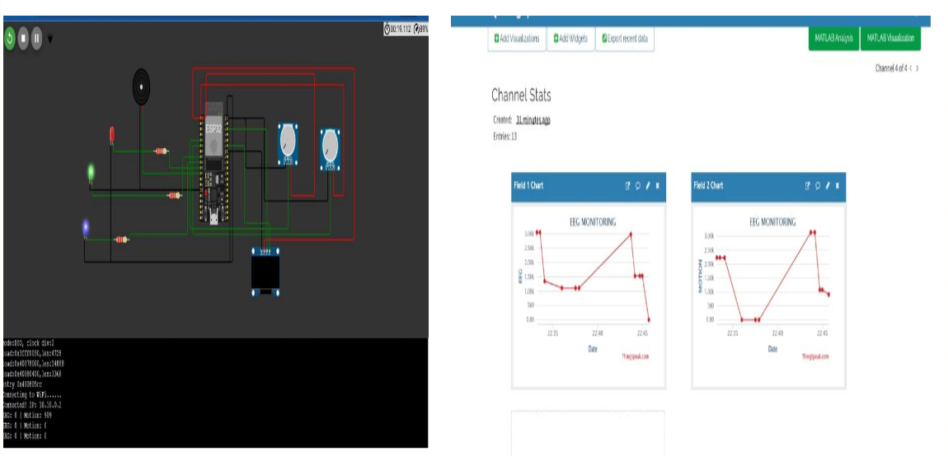
Design & Experimentation

Slide 16
Technical feasibility
The system is based on the established principle of Electroencephalography, which is a reliable and widely used method for monitoring brain activity.
Required hardware and sensing modules are easily available, compatible, and suitable for wearable system design.
Real-time signal processing techniques such as filtering and feature extraction can be efficiently implemented using embedded systems.
Wireless communication enables reliable transmission of data for remote monitoring and analysis.
The system operates with low power consumption, making it suitable for continuous and portable usage.
The overall design is scalable and can be further enhanced with advanced features such as cloud integration and intelligent analysis.

Slide 17
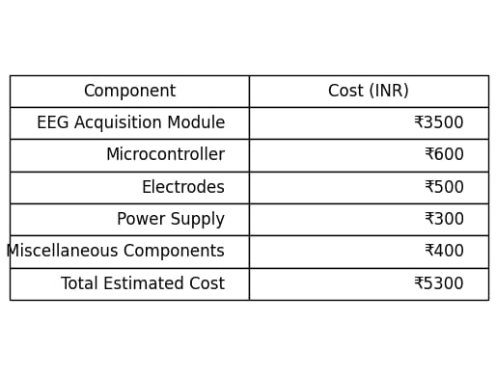
Financial Costing

Slide 18
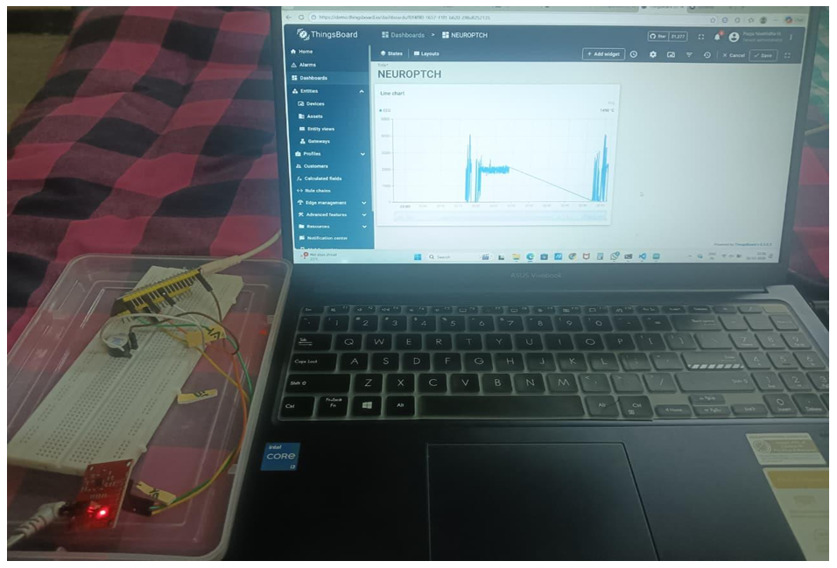
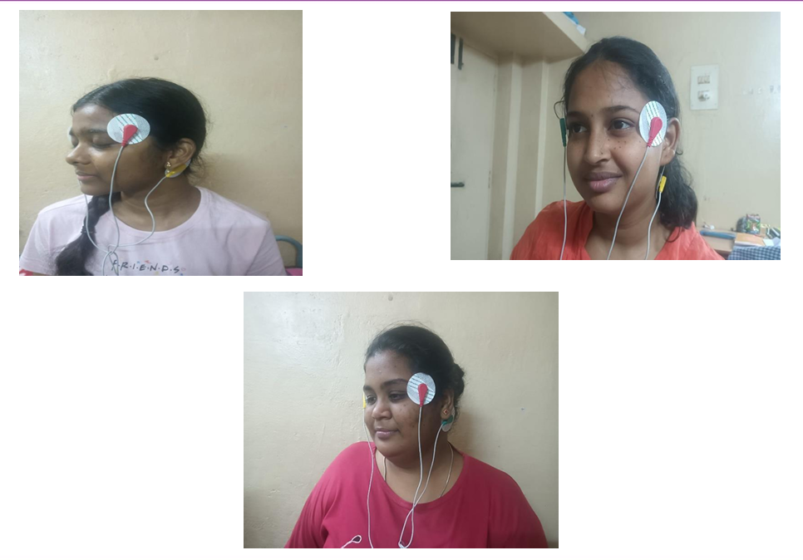
Results & Discussion

Slide 19
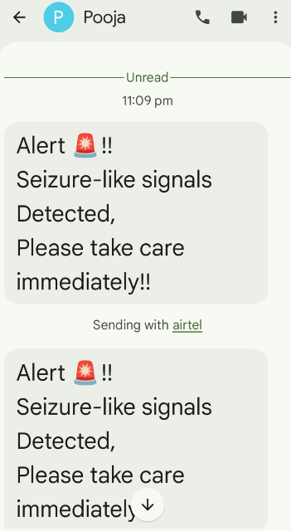
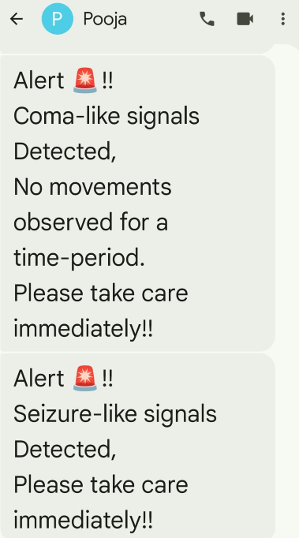
Results

Slide 20
Scope for future wok
Integrate real EEG signals from ADS1299 and dry electrodes instead of synthetic data.
Calibrate thresholds for seizure, paralysis, and coma detection for accurate monitoring.
Enhance signal processing with RMS, peak detection, and optionally FFT for better EEG analysis.
Optimize IoT visualization and alerts on ThingSpeak, including data upload timing and notifications

Slide 21
Outcomes - Conclusion
The NeuroPatch system successfully demonstrates a compact and wearable solution for real-time brain activity monitoring based on the principles of Electroencephalography. The system is capable of acquiring brain signals, processing them efficiently, and identifying abnormal patterns such as irregular neural activity. The integration of embedded processing and wireless communication enables continuous monitoring and remote accessibility of data. The developed prototype shows stable performance in signal acquisition and real-time analysis, ensuring reliability for basic neurological observation. Additionally, the alert mechanism provides immediate notifications during abnormal conditions, improving response time and user safety.
In conclusion, the NeuroPatch project provides a cost-effective, portable, and efficient alternative to traditional EEG monitoring systems. The system reduces dependency on bulky clinical equipment and enables continuous monitoring in non-clinical environments. Its scalability allows future enhancements such as advanced signal analysis and integration with intelligent healthcare systems. Overall, the proposed solution contributes to improved healthcare accessibility, early detection of neurological disorders, and enhanced patient safety through real-time monitoring and alert generation.

Slide 22
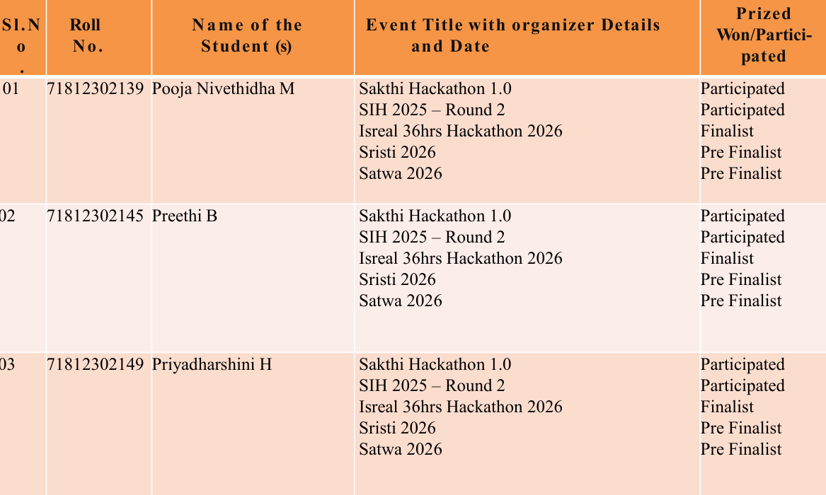
Outcomes (Patent, Paper, Hackatons etc.,) – applied / published / granted

Slide 23
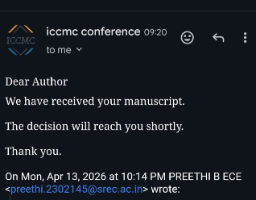
Outcomes (Patent, Paper, Hackatons etc.,) – applied / published / granted

Slide 24
SDG Goals
The project titled Development Of Neuropatch: A Smart Skin Patch For Brain Monitoring And Response aligns with SDG 3: Good Health and Well-Being.
Reason for Mapping:
SDG 3 By enabling early diagnosis, continuous monitoring and better patient care for people having neurological disorders, our project is directly contributing to SDG 3. With NeuroPatch we can monitor brain signals in real time and without need electroencephalogram device It can help in the early detection of seizures, monitoring of coma patients and detection of intent signals in cases of paralysis, etc. PC is used for real-time monitoring. Proof of this system is obtained.achievable easily by doctors. The suggested system would be beneficial in the. Identifying Neurological Disorders in Outpatient Settings. Intelligent is to be a relevant resource for interviews. and brain checks The continuous monitoring here is done by means of proportioning to remove.The patient does not have to carry devices with him.Those suffering from it. The device assists during an arrest. The patient’s early intervention by measurement of brain waves.

Slide 25
References
[1] Golmohammadi, M., Ziyabari, S., Shah, V., & Lopresti, D. (2018). Deep architectures for automated seizure detection in scalp EEGs. Proceedings of the IEEE Signal Processing in Medicine and Biology Symposium (SPMB), 1–5. https://doi.org/10.1109/SPMB.2018.8615602
[2] Avcu, G., Abdelhameed, I., & Islam, M. R. (2019). Seizure detection using least EEG channels by deep convolutional neural network. Signal, Image and Video Processing, 13(5), 997–1004. https://doi.org/10.1007/s11760-018-01423-2
[3] Huang, Y., Chen, M., & Yin, E. (2021). A novel deep learning model for motor imagery classification in brain–computer interfaces. Frontiers in Neuroscience, 15, 774857. https://doi.org/10.3389/fnins.2021.774857
[4] Salami, M., Siuly, S., Wang, H., & Zhang, Y. (2022). EEG-ITNet: Explainable Inception Temporal CNN for motor imagery classification. IEEE Journal of Biomedical and Health Informatics, 26
(5), 2156–2166. https://doi.org/10.1109/JBHI.2022.3146181 [5] Roy, Y., Banville, H., Albuquerque, I., Gramfort, A., Falk, T. H., & Faubert, J. (2019). Deep learning-based electroencephalography analysis: a systematic review. Journal of Neural Engineering, 16(5), 05100. https://doi.org/10.1088/1741-2552/ab260c

